Slide 1

Team Orus
Java Teamwork Project

Slide 2
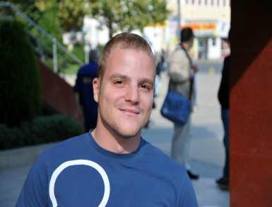

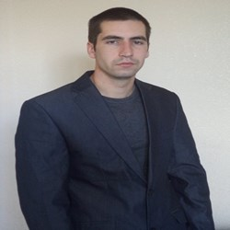
Team members
Hristo Petrov – game logic
Ivan Yonkov – game logic
Petko Pasev – game design

Slide 3
Project Task
Task:
Create console-based/GUI-based game
Team “Orus” project name:
“Pesho, The Hungry Sumist”

Slide 4

“Food” demo

Slide 5
Tools and Resources
Language: Java
IDE: Eclipse
Libraries: Swing, AWT
Source control tool: GitHub
Web: Google
Web: Google

Slide 6
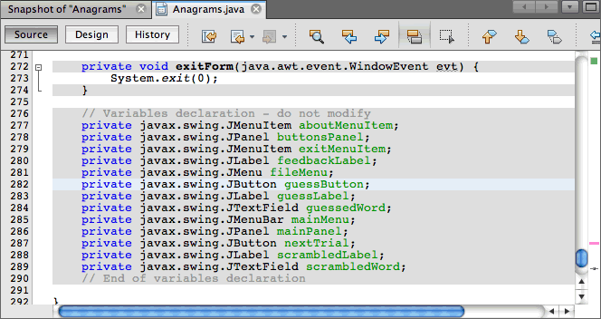
Source preview

Slide 7
Thank you for your attention

